Slide 1
Cambridge
IGCSE
Computer Science
Paper 1
Barcode readers, scanners and cameras
Unit 3: Input and output devices
1

Slide 2
Objectives:
Describe the principles of operation of the following direct input devices:
Barcode readers
Scanners
QR (Quick Response) code scanners
Digital cameras
Describe how these principles are applied to real-life scenarios

Slide 3
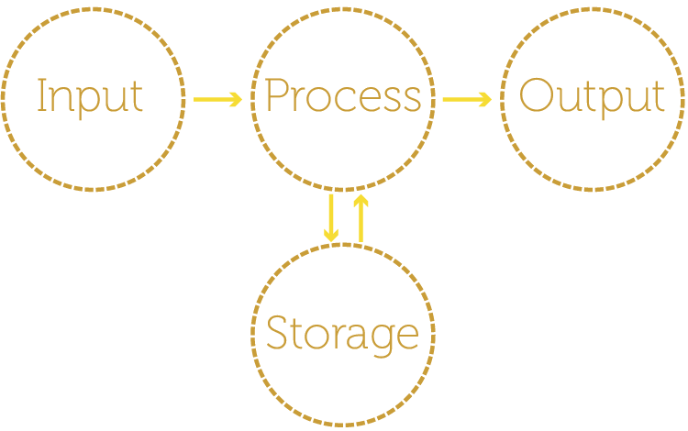
Inputs and outputs
Watch video - Input Devices

Slide 4
Input devices
Input devices transfer data from the source in the outside world to the computer
Some do part of this automatically and these devices include:
Scanners
Barcode readers
Digital cameras
Manual input devices require greater human intervention to generate the data using keypresses, mouse clicks or a touch pad

Slide 5
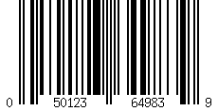
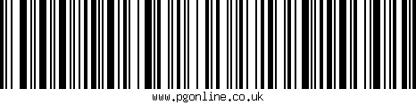
Barcode readers
Two common types of barcode system:
Universal Product Code version ‘A’ (UPC-A)
Used in retail and warehousing
Code 128
Used in transport and shipment tracking
Code 128 can represent letters and numbers whilst UPC-A can only represent numeric digits

Slide 6
UPC-A systems
This uses long guard bars to show the start and end of the barcode and also central guard bars to distinguish left uniquely from right
UPC-A uses seven bar elements to form four alternating dark and light bars of varying thicknesses to represent each data item between the guard bars
Left: Manufacturer number
Right: Product number

Slide 7
UPC-A barcode anatomy
Start
Check digit
Left Right
Guard bars
 |  |  |  |  |  |  | 3
 |  |  |  |  |  |  | 3

Slide 8
Reading UPC-A retail barcodes
Visually, a grouping of two or more adjacent bars appear as a single wide bar
Right hand codes are the inverse of left hand codes
Left hand codes all have an odd number of black bars. Right hand codes all have an even number
How could this be useful?
 |  |  |  |  |  |  | 0
 |  |  |  |  |  |  | 1
 |  |  |  |  |  |  | 2
 |  |  |  |  |  |  | 3
 |  |  |  |  |  |  | 4
 |  |  |  |  |  |  | 5
 |  |  |  |  |  |  | 6
 |  |  |  |  |  |  | 7
 |  |  |  |  |  |  | 8 |  |  |  | 0
 |  |  |  |  |  |  | 9
Left Right

Slide 9
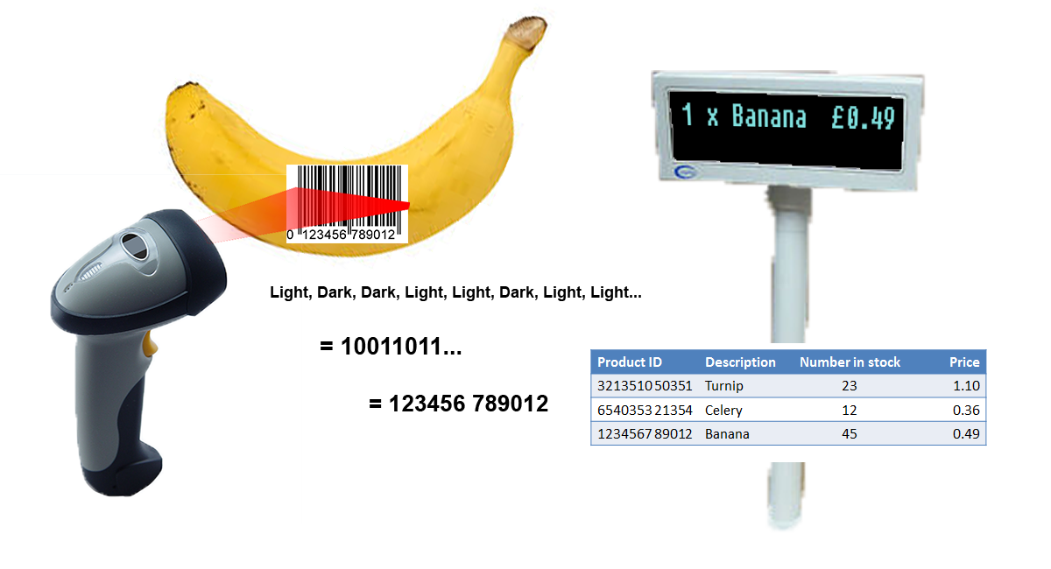
Barcode readers

Slide 10
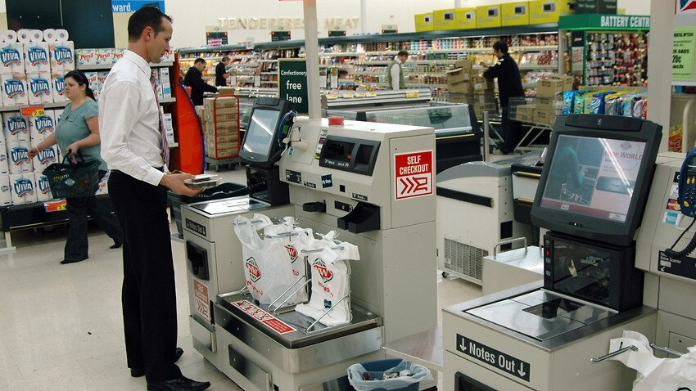

Slide 11
How a scanner reads a barcode
The scanner shines a light at the barcode
Light is reflected back to the scanner
White lines reflect light
Black lines reflect less light
Photoelectric cells in the scanner detect the light
The pattern of lines is converted to digital values
A microprocessor interprets the data
For example the number ‘3’ generates the pattern: L D D D D L D (L – Light, D – Dark) So binary = 0 1 1 1 1 0 1

Slide 12
Barcode readers are commonly found at the checkout in supermarkets.
So the barcode has been read, what happens next?
The barcode number is looked up in the stock database (the barcode is known as the KEY FIELD in the stock item record); this key field uniquely identifies each stock item.
When the barcode number is found, the stock item record is looked up.
The price and other stock item details are sent back to the checkout (or POINT OF SALE TERMINAL (POS)).
The number of stock items in the record is reduced by one each time the barcode is read.
The number of stock items is compared to the re-order level; if it is less than or equal to this value, more stock items are automatically ordered.
Once an order for more stock items is generated, a flag is added to the record to stop re-ordering every time the stock item barcode is read.
When new stock items arrive, the stock levels are updated in the database .

Slide 13
Advantages of using bar codes to the management include:
• much easier and faster to change prices on stock items
• much better, more up·to-date sales information/sales trends
• no need to price every stock item on the shelves (this reduces time and cost to the management)
• allows for automatic stock control
• possible to check customer buying habits more easily by linking barcodes to, for example, customer loyalty cards.
Advantages of using bar codes to the customers include:
• faster checkout queues (staff don't need to remember or look up prices of items)
• errors in charging customers are reduced
• the customer is given an itemised bill
• cost savings can be passed on to the customer
• better track of sell by dates, so food should be fresher.
The barcode system is used in many other areas. For example, it can be utilised in libraries where barcodes are used in books and on the borrower's library card. Every time a book is taken out, the borrower is linked to the book automatically. This allows automatic checking of when the book is due to be returned, for example.

Slide 14
QR (Quick Response) codes
QR codes are 2D barcodes and can be read by smartphones or tablets
They can contain:
Links to websites or
Information
Try scanning these codes as examples:

Slide 15
The QR code is made up of a matrix of filled -in dark squares on a light background.
To make a comparison, normal bar codes can hold up to 30 digits; QR codes can hold over 7000 digits. This obviously gives greater scope for the storage of information.
Because of modern smart phones, which allow internet access on the move, QR codes can be scanned anywhere. This allows advertising of products on trains, buses, shopping malls and many other places. By using the built·in camera facility on modern phones and down loading the appropriate application (or app), it is possible to read the QR code. The code may contain a website link or some form of advertising (e.g. special offers on pizzas).
For example, a QR code could contain a phone number and an advertisement for free pizzas if ordered today. On scanning the QR code, the phone number and advertisement will appear on the mobile phone's screen.
Advantages of QR codes include:
• there is no need for the user to write down or key in a website address; scanning the QR code does this automatically
• QR codes can store website addresses or URLs that appear in magazines, trains, buses or even on business cards, giving a very effective method of advertising.

Slide 16
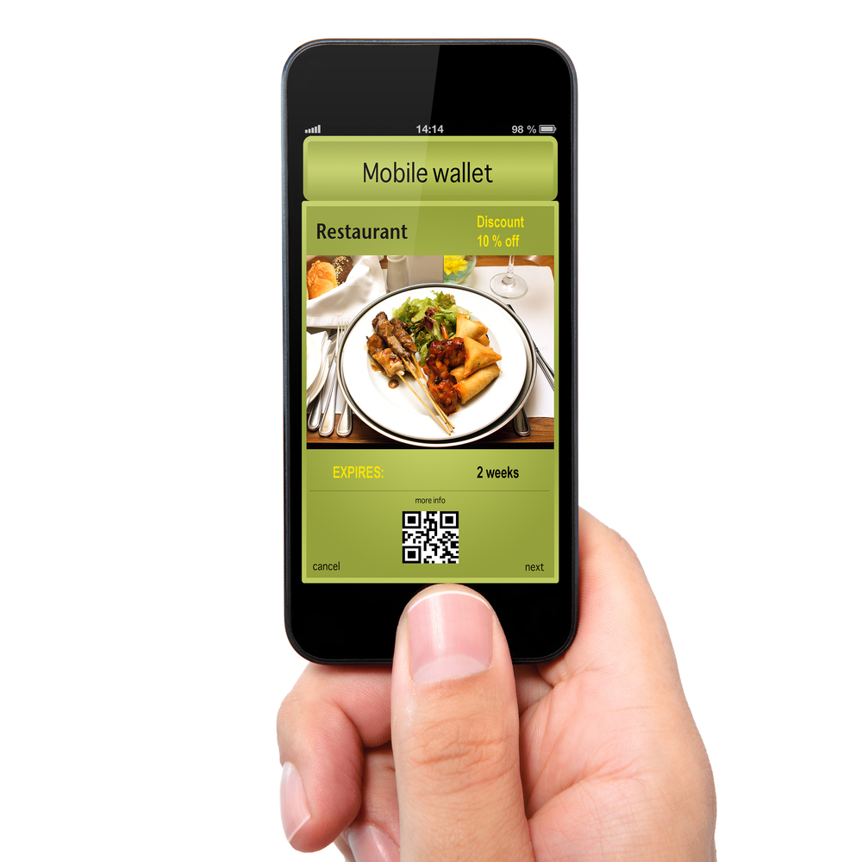
Uses of QR codes in society
Common uses include:
Restaurant coupons
Mobile concert tickets
Real estate agency boards
Business cards
Tourist information
Advertising posters

Slide 17
Worksheet 1
Complete Task 1 to read and create a barcode manually
 |  |  |  |  |  |  | 0
 |  |  |  |  |  |  | 1
 |  |  |  |  |  |  | 2
 |  |  |  |  |  |  | 3
 |  |  |  |  |  |  | 4
 |  |  |  |  |  |  | 5
 |  |  |  |  |  |  | 6
 |  |  |  |  |  |  | 7
 |  |  |  |  |  |  | 8 |  |  |  | 0
 |  |  |  |  |  |  | 9
Left Right

Slide 18
The differences between barcodes and QR codes
Barcodes contain vertical lines and QR codes contain ‘squares’
QR code can hold more data than a barcode
QR code can be read from any angle, some barcode readers have to be lined up with the barcode QR codes are more error tolerant / faster to scan than barcodes
Barcodes are frequently used at checkouts / libraries QR codes are used for advertising QR codes are frequently used by mobile phones to obtain information

Slide 19
Activity
Create two posters about 1 Barcodes and 2 QR codes
or create one poster comparing Barcodes and QR codes.
The posters must have an introduction about each, explain how they work, give examples of where they are used, and advantages and disadvantages.
Good presentation is also important, and will be marked.
Use your books, notes and the internet for research.
Finish for homework.

